Slide 1
Think Parallel
the Fundamentals of Parallel Programming
James Reinders (Intel)

Slide 2
Think Parallel
Be motivated!
Concurrency vs. Parallelism
Our programming job: provide maximal opportunity for parallelism
Opportunity is different than required
Parallelism is where the data is
Amdahl’s Law creates unnecessary pessimism
Gustafson encouraged use to rethink Amdahl’s Law
Scaling is important
Optimal scalar is often different than ‘optimal ready to scale’

Slide 3
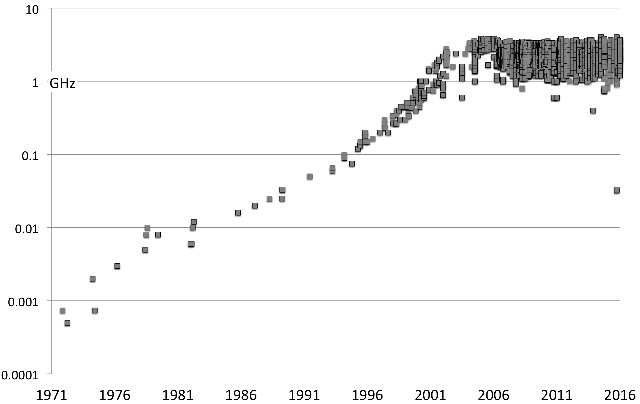
motivation
. rates over time.
Growth of processor clock .
1973 1MHz, 2003 1 GHz 2004 3 GHz, similar today… power wall + ILP wall + memory wall
solve: parallel hardware + explicit parallel software + software memory optimization

Slide 4
concurrency vs. parallelism
concurrency
parallelism
composition of independently executing processes
dealing with lots of things at once
simultaneous execution of (possibly related) computations
doing lots of things at once

Slide 5



concurrency vs. parallelism
Concurrent = two queues, one caffeine dispenser
Parallel = two queues, two caffeine dispensers

Slide 6
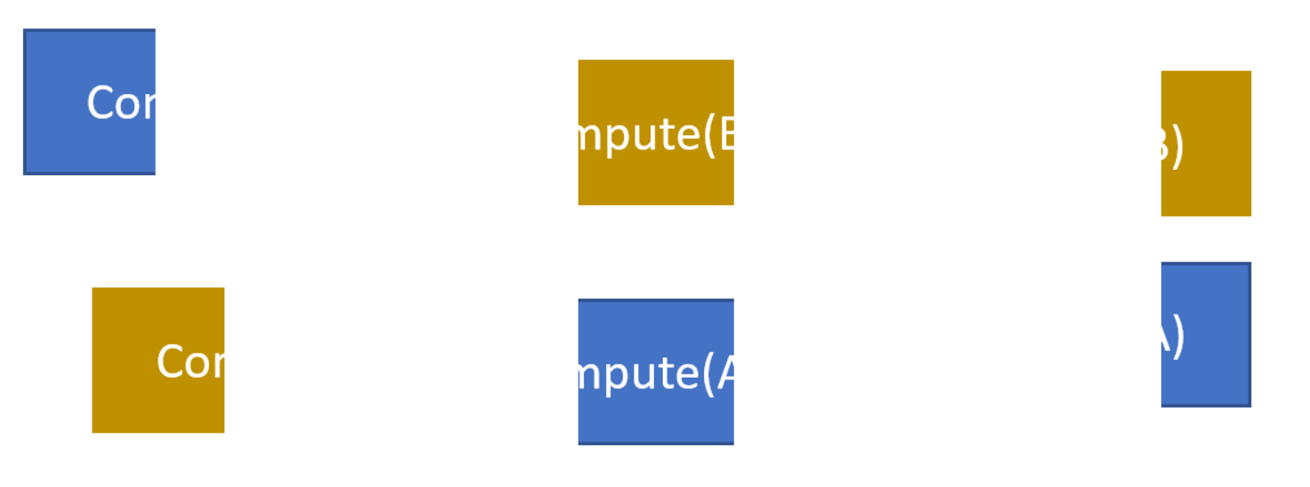
concurrency vs. parallelism
Three independent computations.
Sequential
Compute(A)
Compute(B)
Compute(C)
time
Concurrent
Compute(C)
time
Compute(A)
Parallel
Compute(B)
Compute(C)
time

Slide 7
How much parallelism is there?
Amdahl’s Law
Gustafson’s observations on Amdahl’s Law

Slide 8
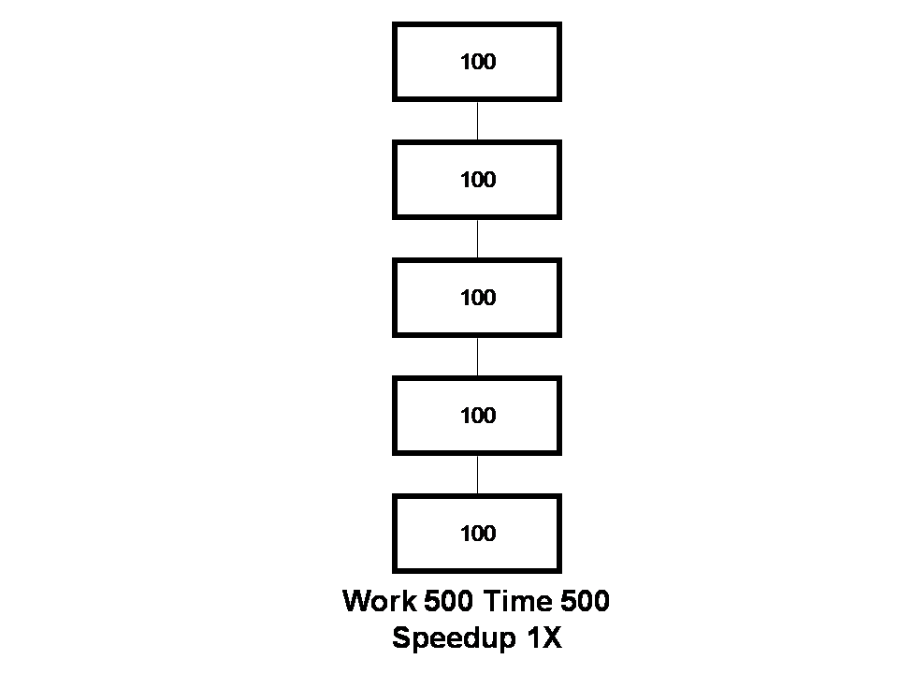

Slide 9
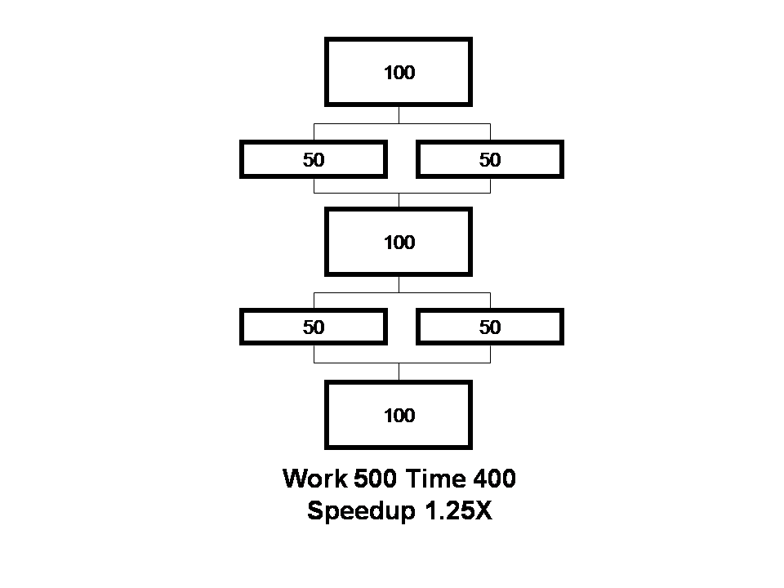

Slide 10
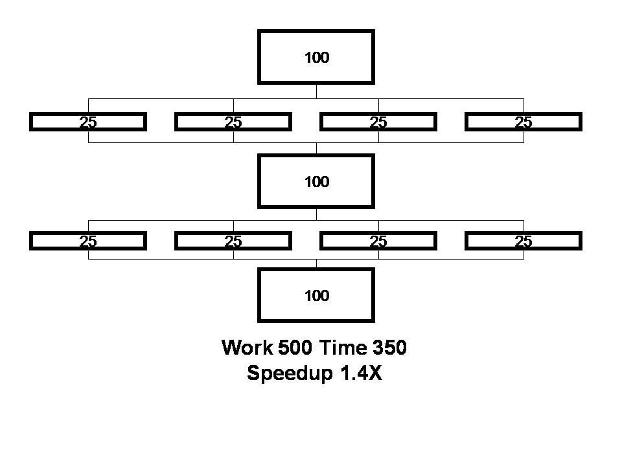

Slide 11
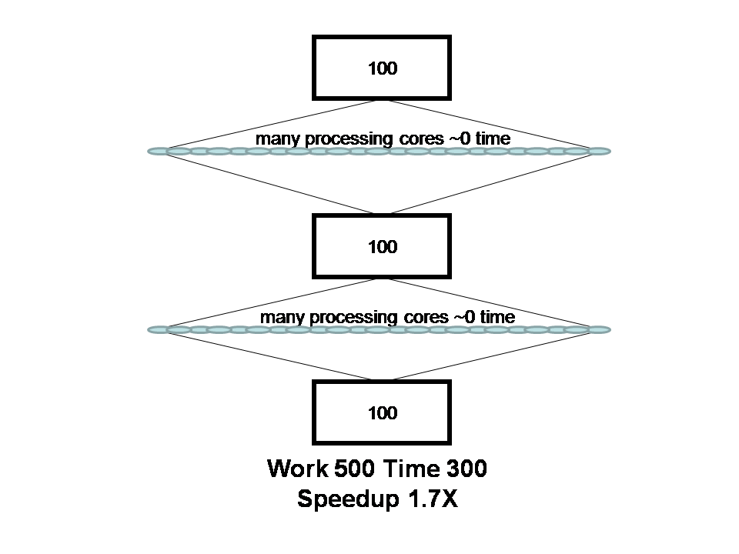

Slide 12
That’s all? A reduction of only 40% percent in time???

Slide 13
Amdahl’s law
“…the effort expended on achieving high parallel processing rates is wasted unless it is accompanied by achievements in sequential processing rates of very nearly the same magnitude.”
– Amdahl, 1967

Slide 14
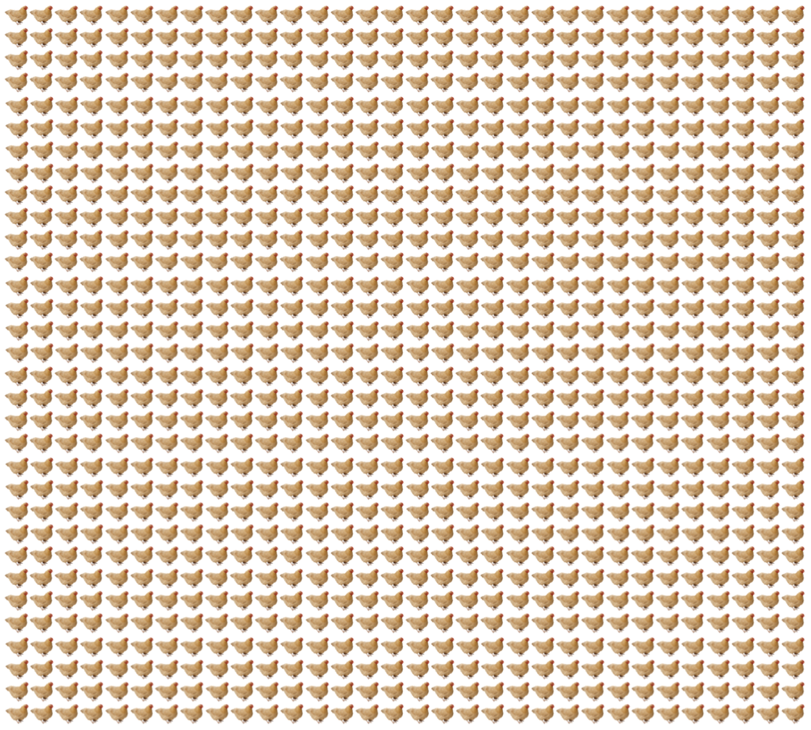

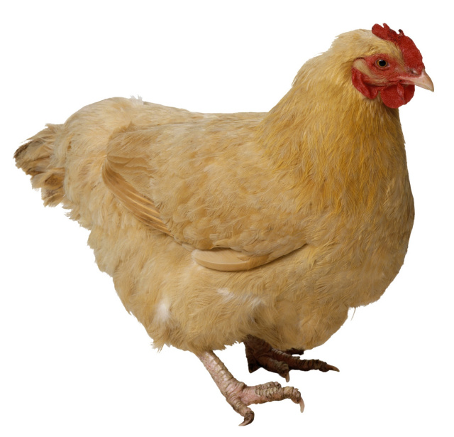

If you were plowing a field,
which would you rather use…
two strong oxen, or
1024 chickens?
- Seymour Cray
Seymour had Amdahl’s Law on his mind. Too much?
We’ll come back to that.

Slide 15
Amdahl’s law
“…the effort expended on achieving high parallel processing rates is wasted unless it is accompanied by achievements in sequential processing rates of very nearly the same magnitude.”
– Amdahl, 1967
Amdahl was not wrong, but his law cast enormous doubt on any hope for parallel computing.

Slide 16
Rethinking Amdahl’s law
“…speedup should be measured by scaling the problem to the number of processors, not by fixing the problem size.”
– Gustafson, 1988
Undaunted, parallel computing enthusiasts continued – and John Gustafson offered an explanation why we might not be crazy.

Slide 18
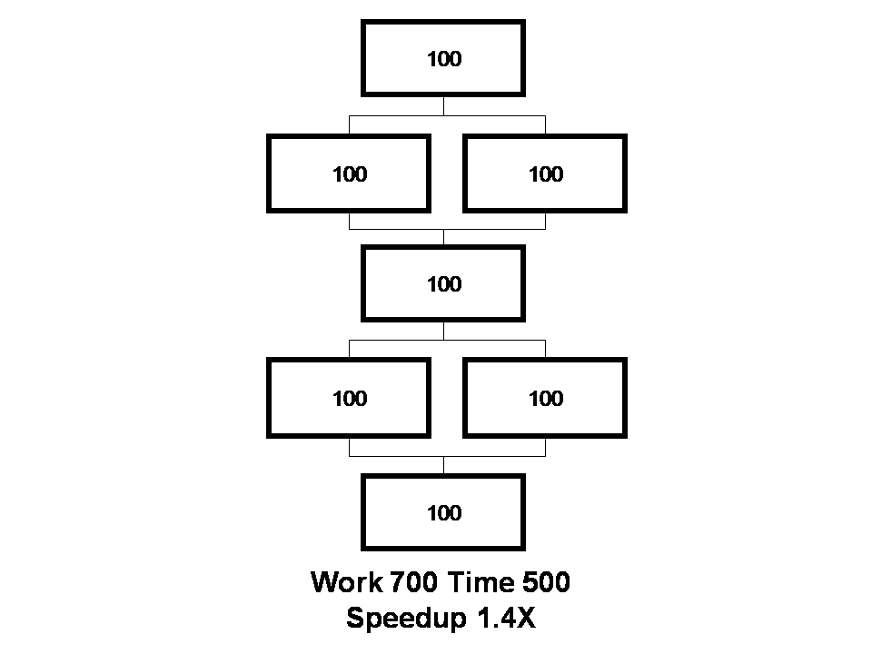

Slide 19
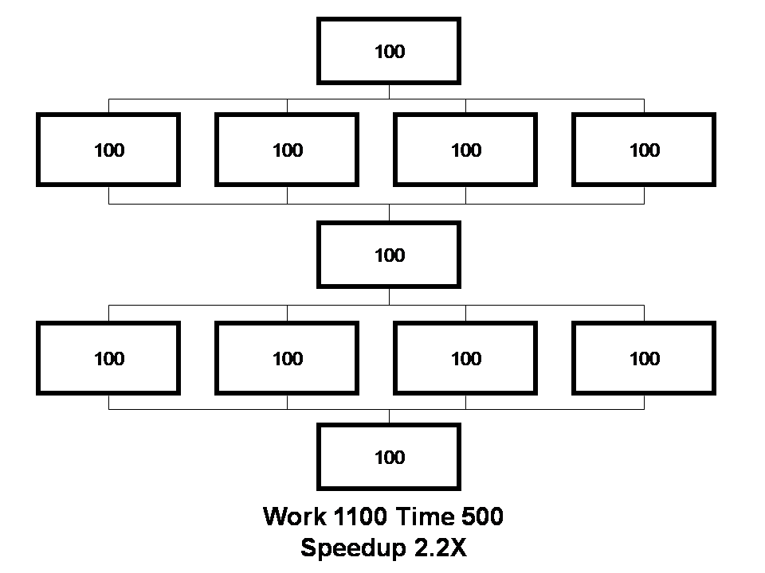

Slide 20
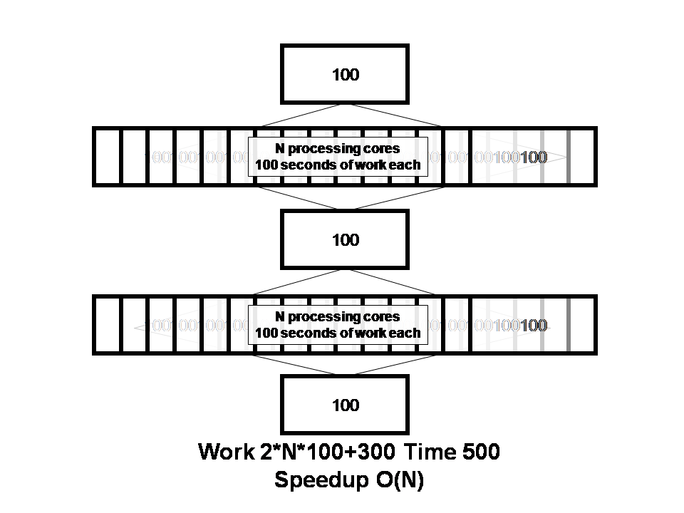

Slide 21
If we scale with data, and we can process data in parallel, we have what we need to scale overall.

Slide 22

How much parallelism is there?
Amdahl’s Law
Gustafson’s observations on Amdahl’s Law
Plenty –
but the workloads need to continue to grow !

Slide 23

Design Question
A few powerful vs. Many much less powerful and very restrictive.
Diagrams for discussion purposes only, not a precise representation of any product of any company.

Slide 24
If you were plowing a field,
which would you rather use…
two strong oxen, or
1024 chickens?
- Seymour Cray

Slide 25
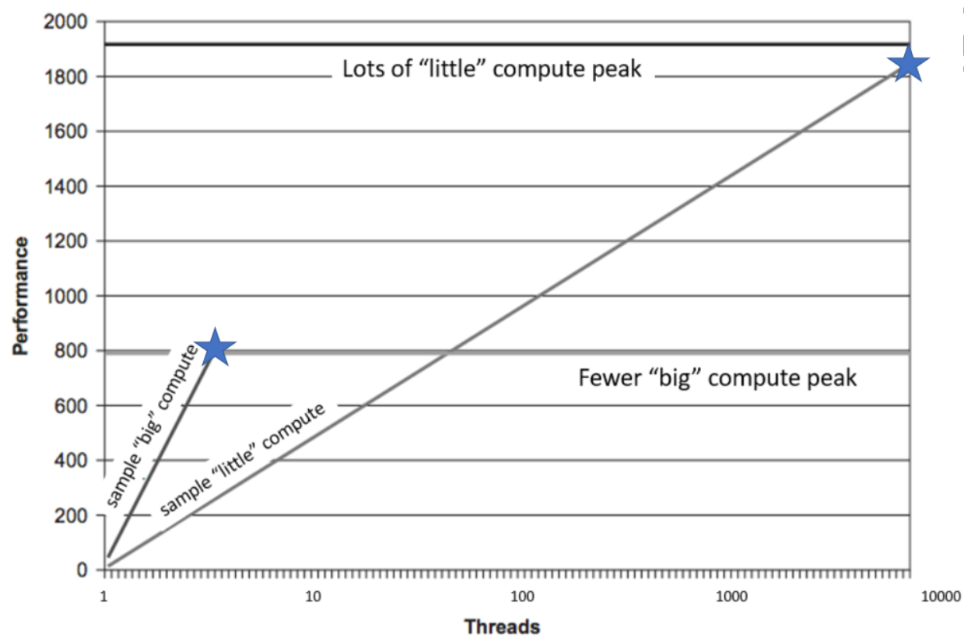
Scaling is key: Lots of little computes can win the race

Slide 26
If you were plowing a field,
which would you rather use…
two strong oxen, or
1024 chickens?
- Seymour Cray
The answer: 10,000 or 100,000 chickens are even better.
It just takes a little work to program them.
Think SYCL !

Slide 27
Think Parallel
Be motivated!
Concurrency vs. Parallelism
Our programming job: provide maximal opportunity for parallelism
Opportunity is different than required
Parallelism is where the data is
Amdahl’s Law creates unnecessary pessimism
Gustafson encouraged use to rethink Amdahl’s Law
Scaling is important
Optimal scalar is often different than ‘optimal ready to scale’

